Slide 1
Statistical Reasoning
Course Code: CSC4226
Course Title: Artificial Intelligence and Expert System
Dept. of Computer Science
Faculty of Science and Technology
Lecture No: | Ten (10) | Week No: | Eleven(11) | Semester:
Lecturer: | Dr. Ashraf Uddin dr.ashraf@aiub.edu

Slide 2
Lecture Outline
Quantifying Uncertainty
Basic Probability Notation
Bayes’ Rules and Its Use
Clinical Trials
The Semantics of Bayesian Network
Prediction in Bayesian Network

Slide 3
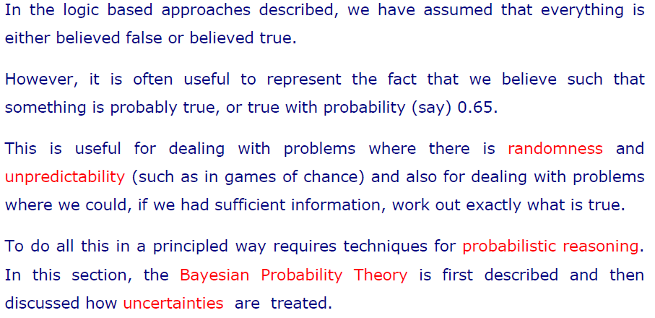
Quantifying Uncertainty

Slide 4
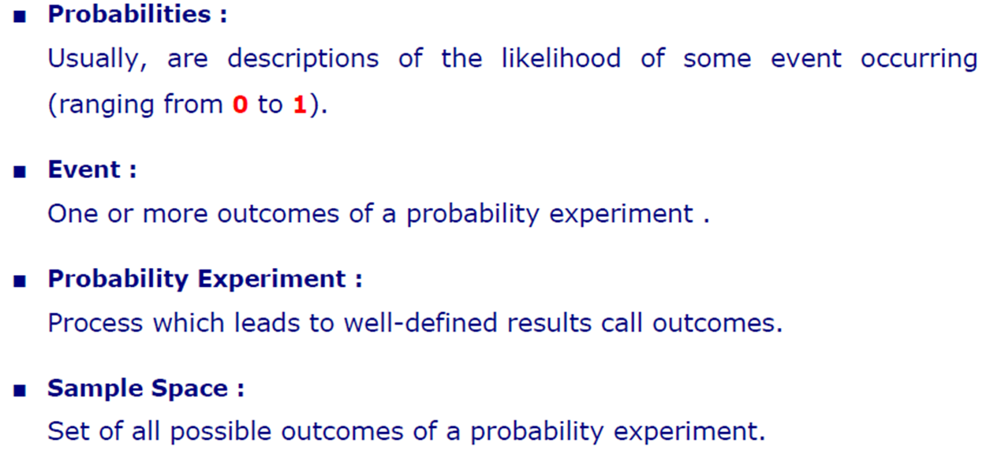
Basic Probability Notations

Slide 5
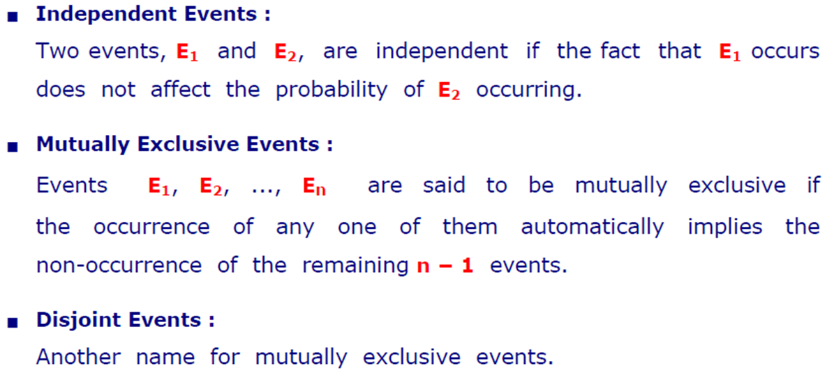
Basic Probability Notations

Slide 6
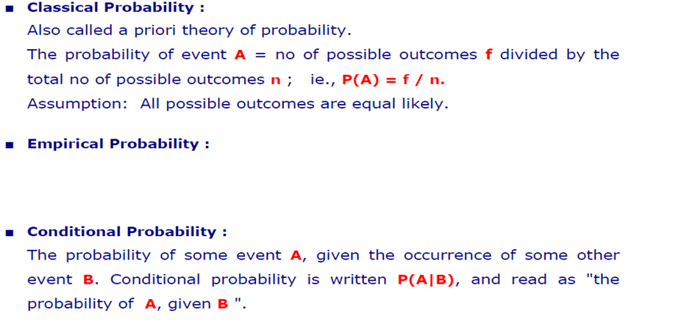
Basic Probability Notations
Empirical probability, also known as experimental probability, refers to probability that is based on historical data. In other words, empirical probability illustrates the likelihood of an event occurring based on historical data.

Slide 7
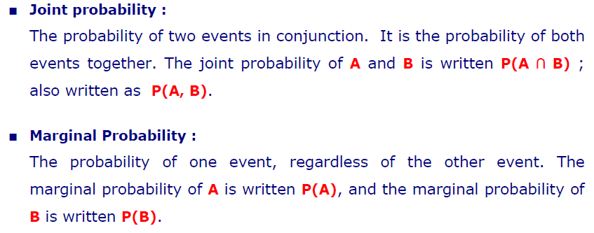
Basic Probability Notations

Slide 8
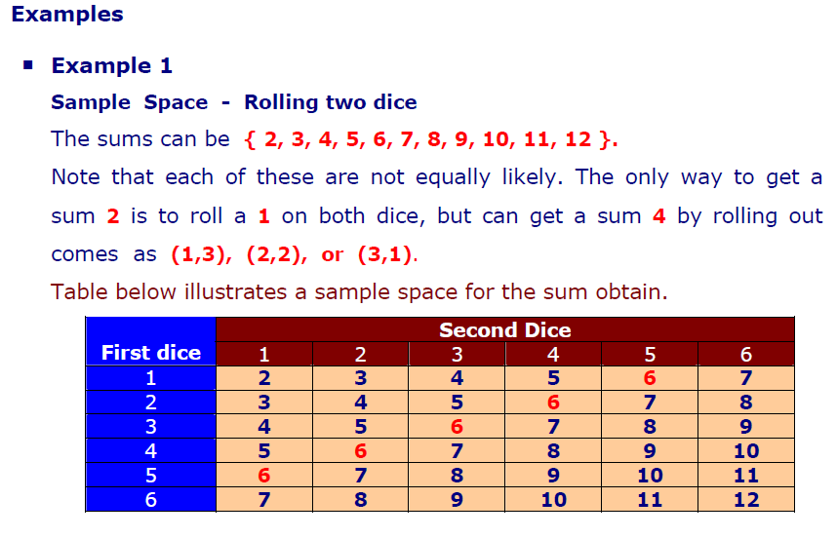
Examples

Slide 9
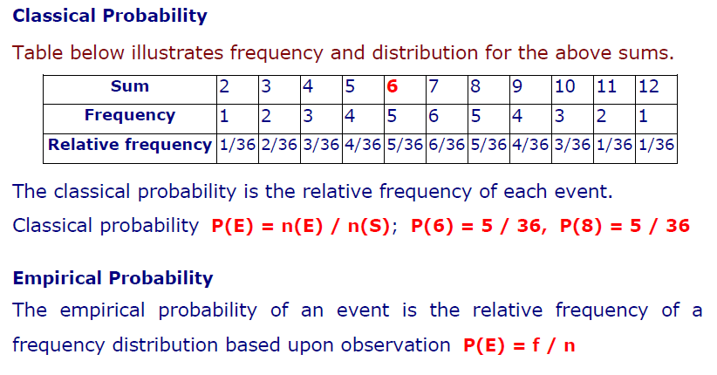
Classical & Empirical Probability

Slide 10
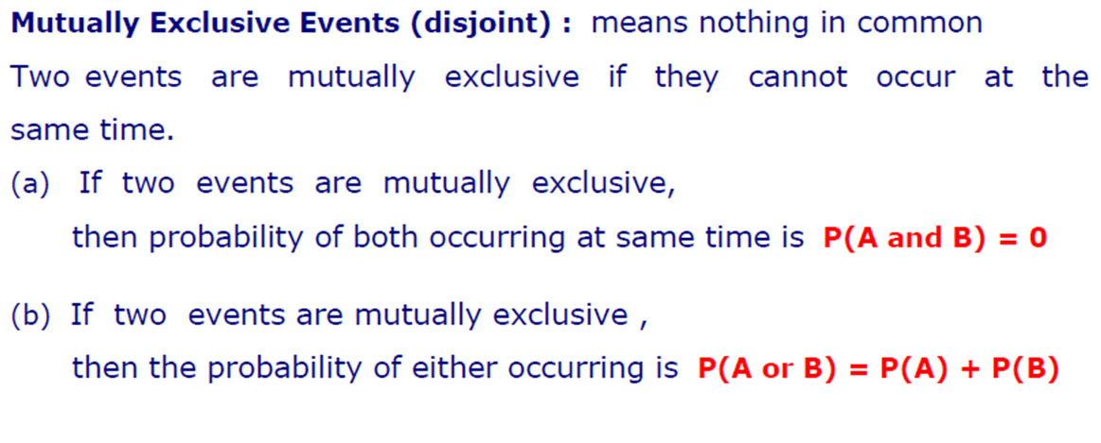
Disjoint Events

Slide 11
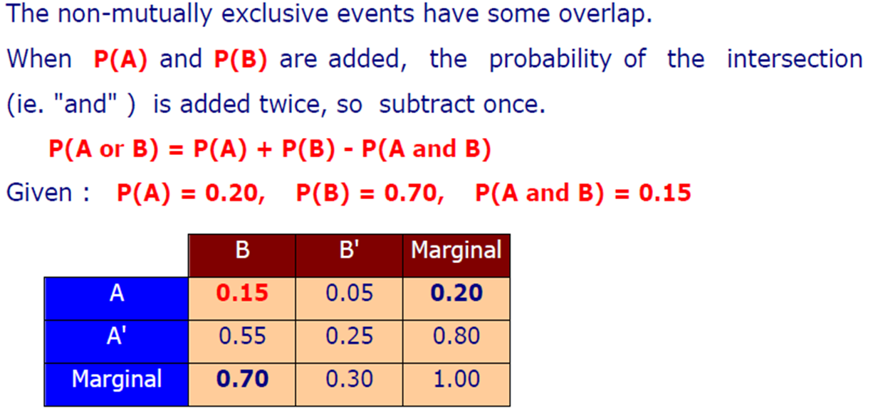
Non-Mutually Exclusive Events

Slide 12
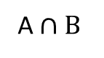
Mutually Exclusive vs Non-Mutually Exclusive Events
Mutually Exclusive
Non-Mutually Exclusive
A
B
A
B
A $∩B$

Slide 13
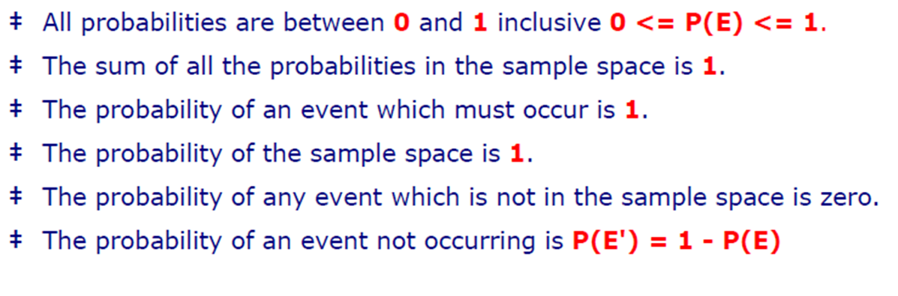
Probability Rules

Slide 14
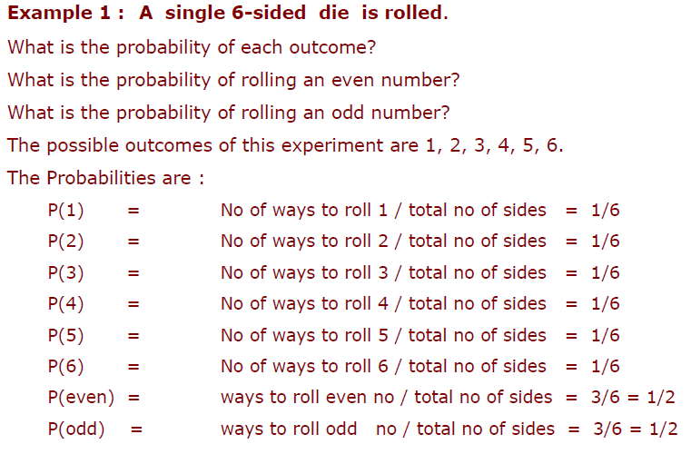
Practice 1

Slide 15
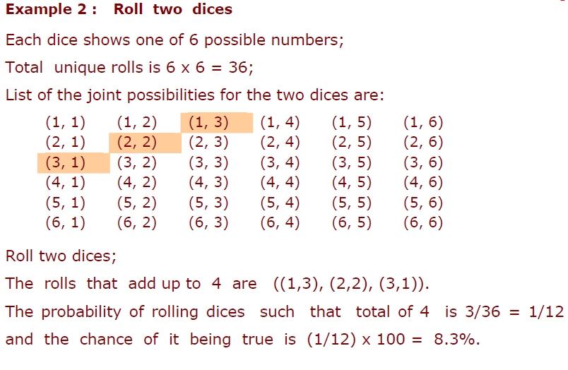
Practice 2

Slide 16
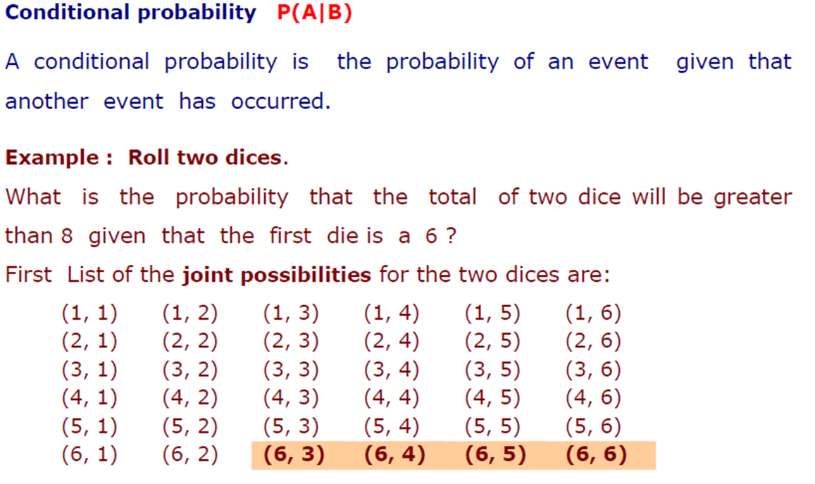
Conditional Probability

Slide 17
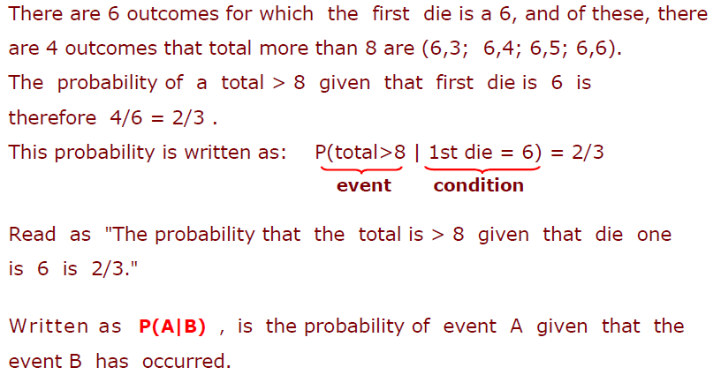

Slide 18
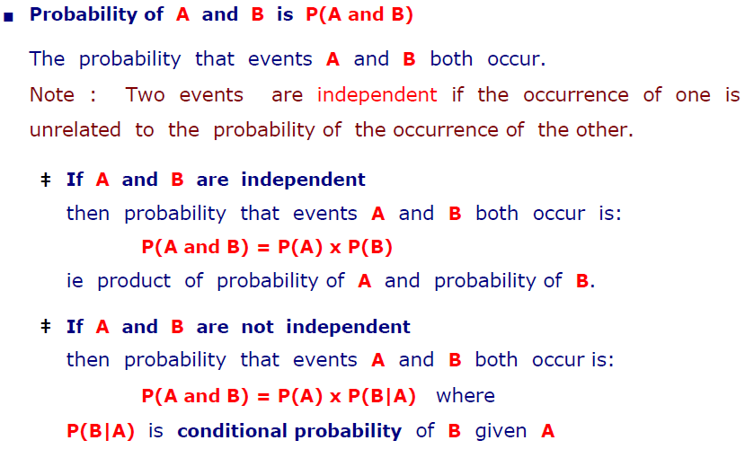
Joint Probability

Slide 19
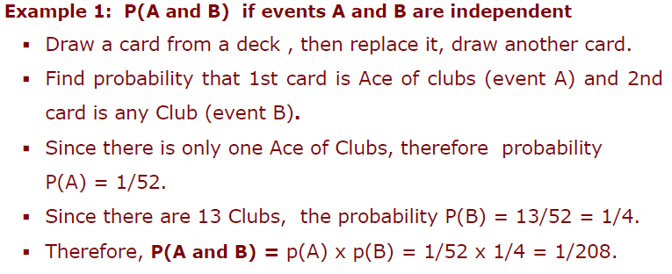
Joint Probability : Independent Events

Slide 20
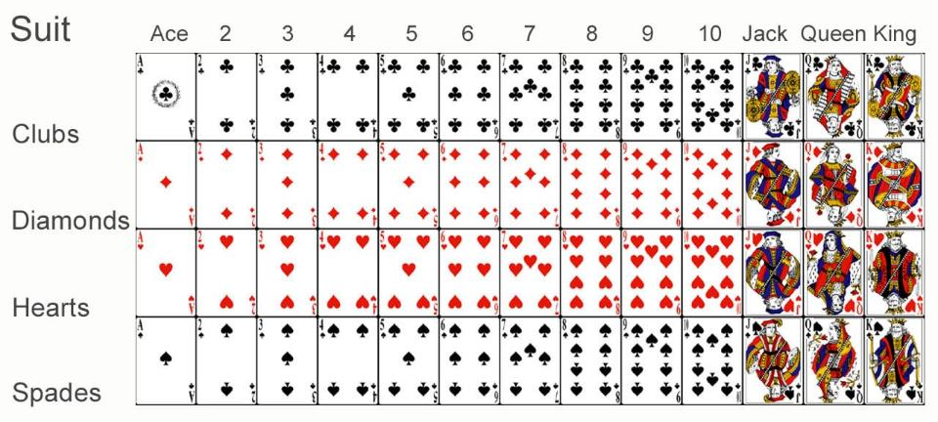
Joint Probability : Independent Events

Slide 21
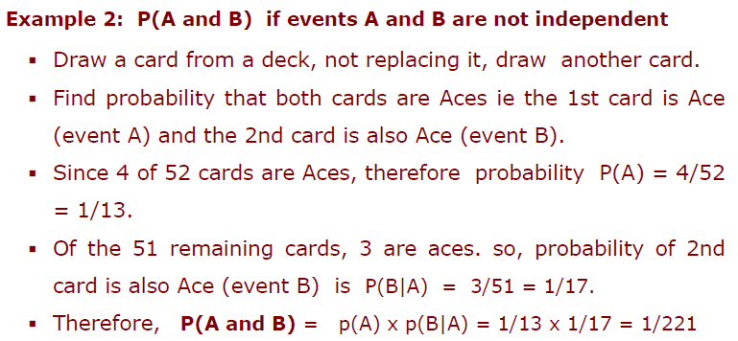
Joint Probability : Dependent Events

Slide 22
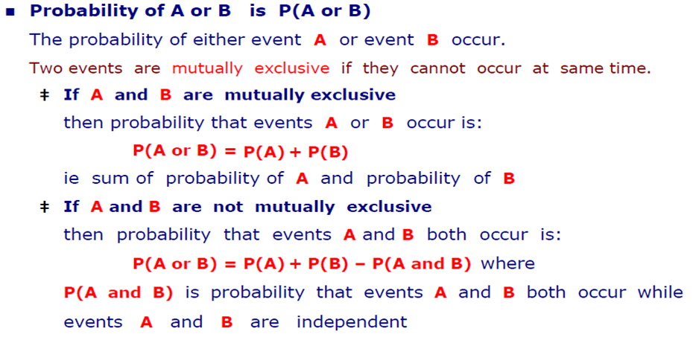
OR Operation

Slide 23
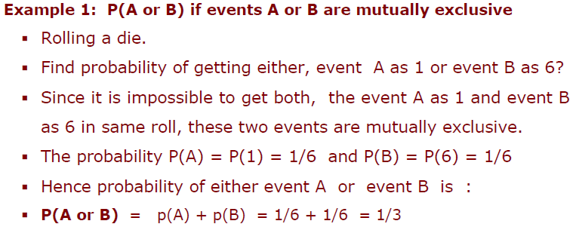
OR Operation: Mutually Exclusive

Slide 24
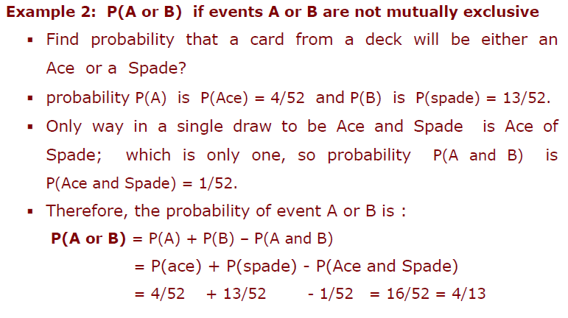
OR Operation: Not Mutually Exclusive

Slide 25
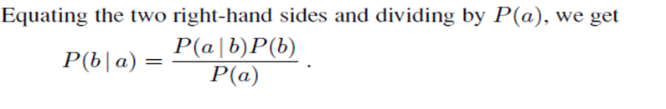
Bayes’ Rule
Product rule can be written in two forms
This equation is known as Bayes’ rule (also Bayes’ law or Bayes’ theorem).
This simple equation underlies most modern AI systems for probabilistic inference.

Slide 26
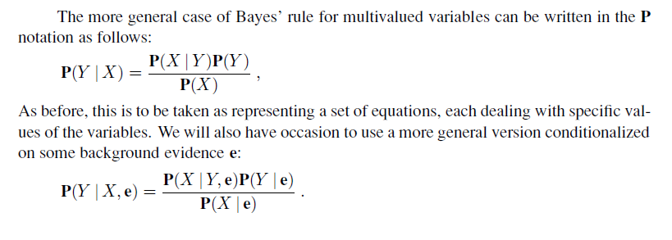
General Case of Bayes’ Rule

Slide 27
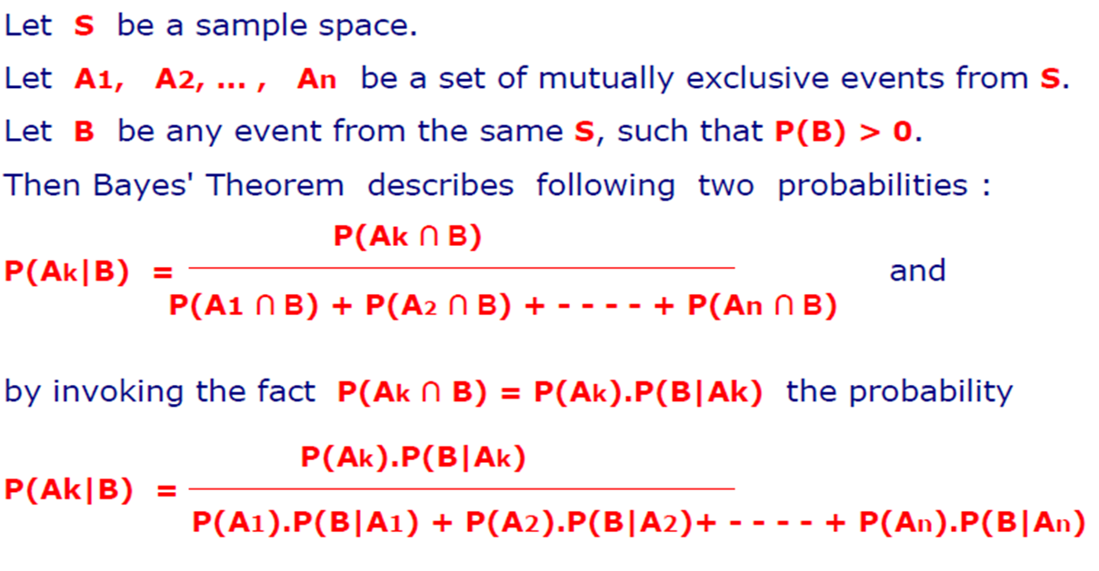
Bayes’ Theorem: Revisited

Slide 28
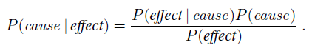
Applying Bayes’ rule: The simple case
The conditional probability P(effect | cause) quantifies the relationship in the causal direction,
whereas P(cause | effect) describes the diagnostic direction
In a task such as medical diagnosis, we often have conditional probabilities on causal relationships (that is, the doctor knows P(symptoms | disease)) and want to derive a diagnosis, P(disease | symptoms).

Slide 29
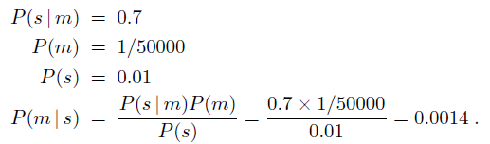
Applying Bayes’ rule: A Simple Example
A doctor knows that
the disease meningitis causes the patient to have a stiff neck, say, 70% of the time.
The doctor also knows some unconditional facts: the prior probability
that a patient has meningitis is 1/50,000,
and the prior probability that any patient has a stiff neck is 1%.
Letting
s be the proposition that the patient has a stiff neck and
m be the proposition that the patient has meningitis, we have

Slide 30
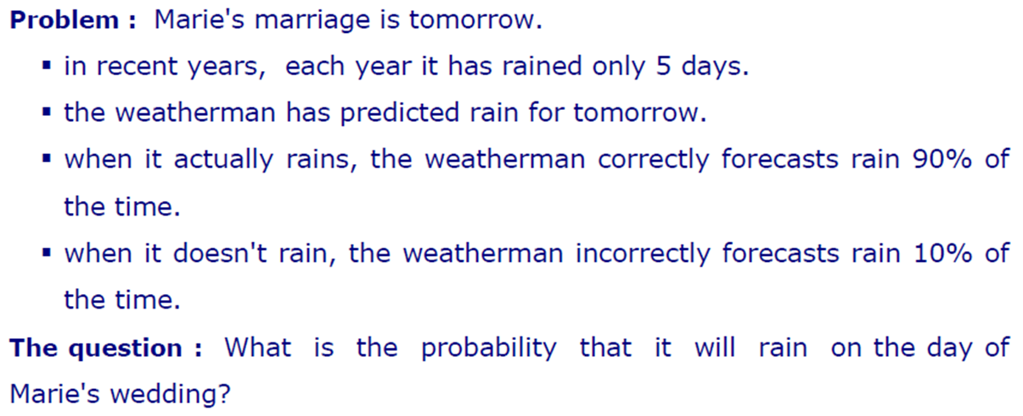
Another Example

Slide 31
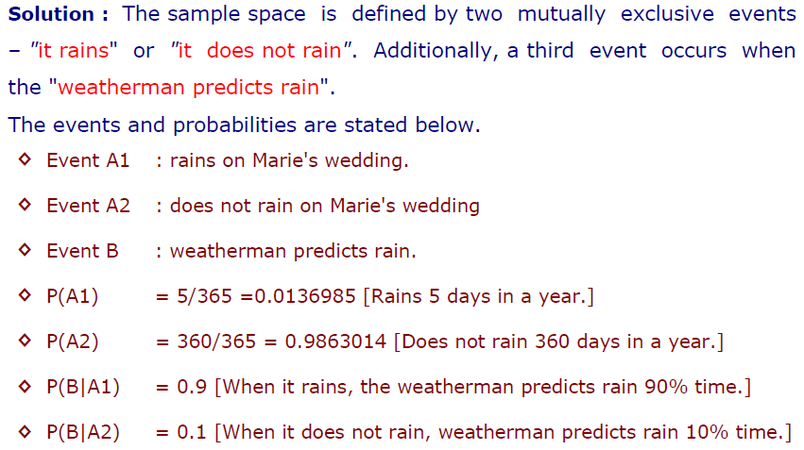
Solution

Slide 32
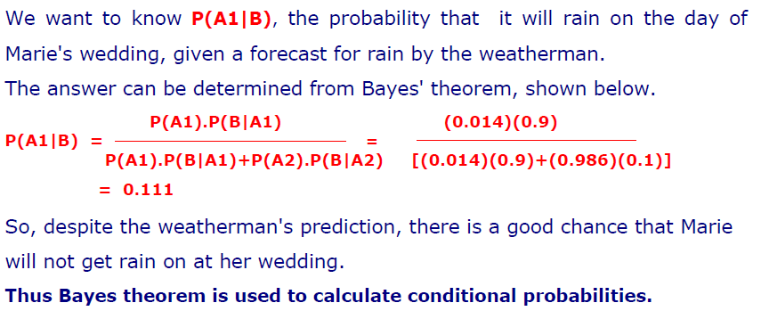
Calculation

Slide 33
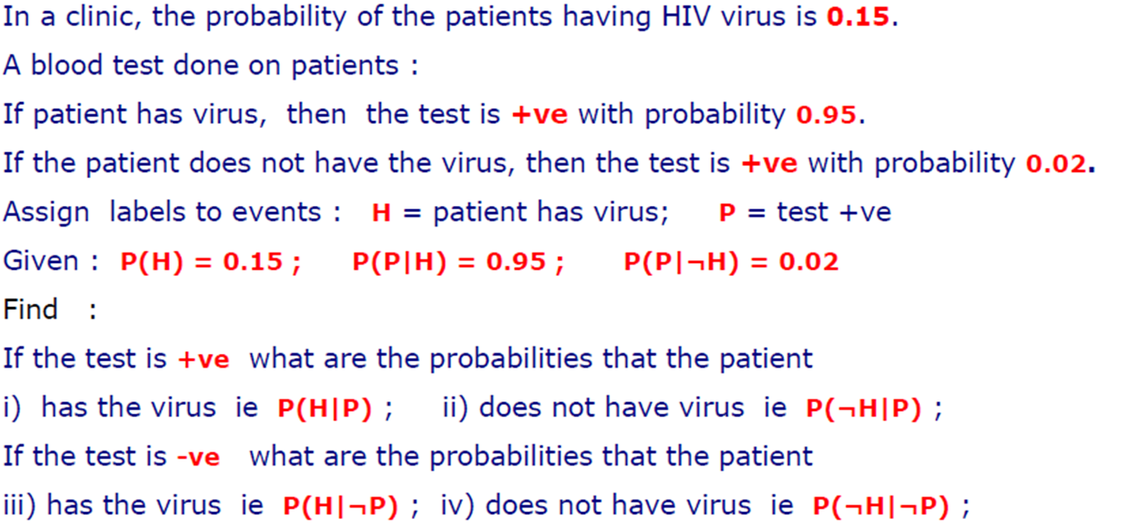
Example: Clinical Trial

Slide 34
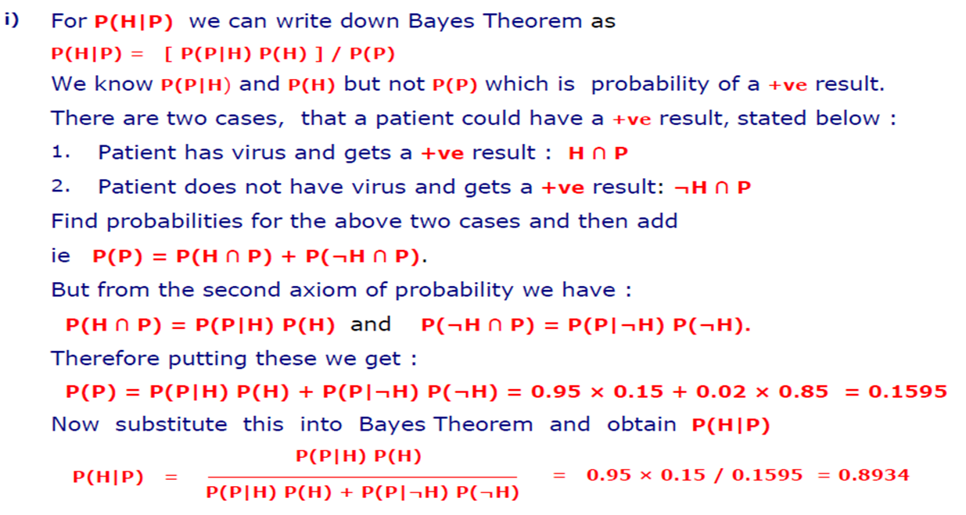
Calculations

Slide 35
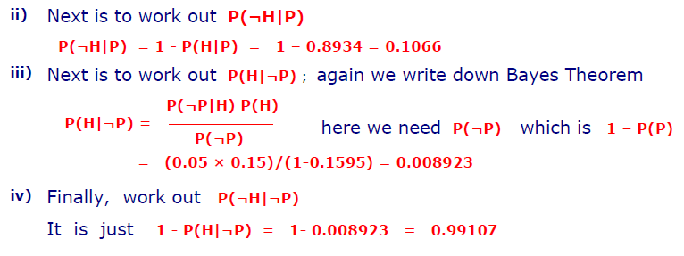
Calculations

Slide 36
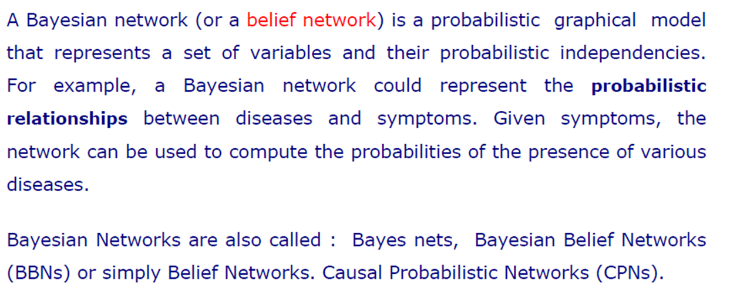
Bayesian Networks

Slide 37
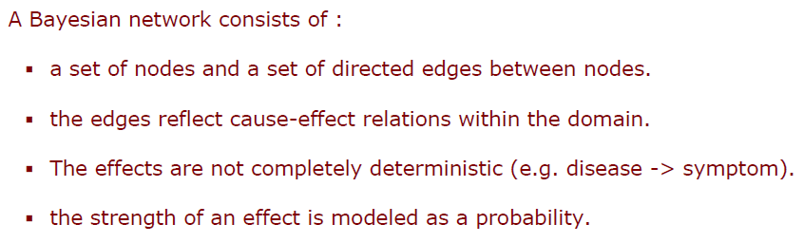
Components of Bayesian Network

Slide 38
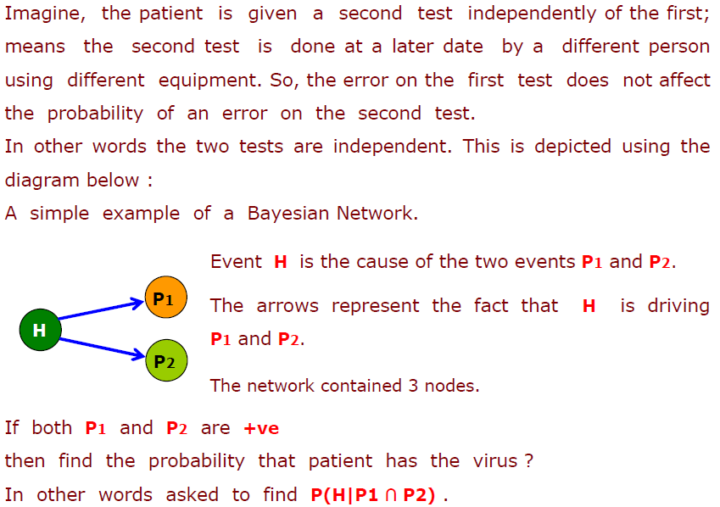
Bayesian Network: Clinical Trial Example

Slide 39
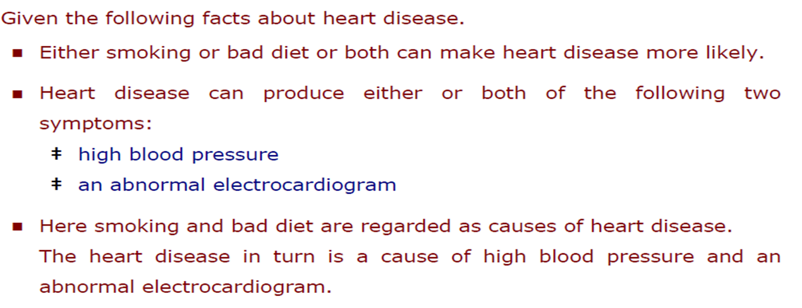
Complicated Bayesian Network

Slide 40
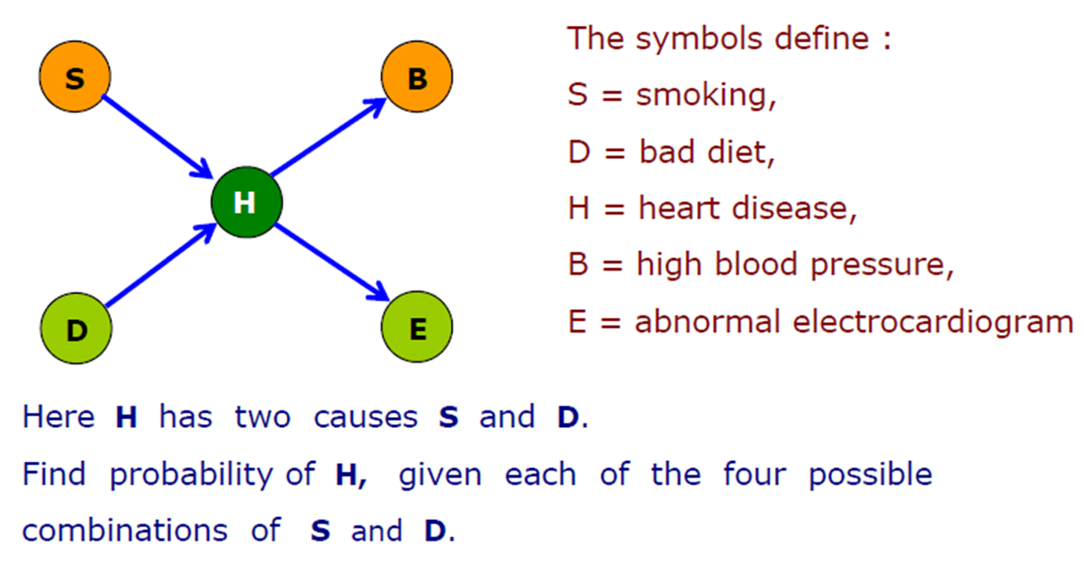
Network of Heart Disease

Slide 41
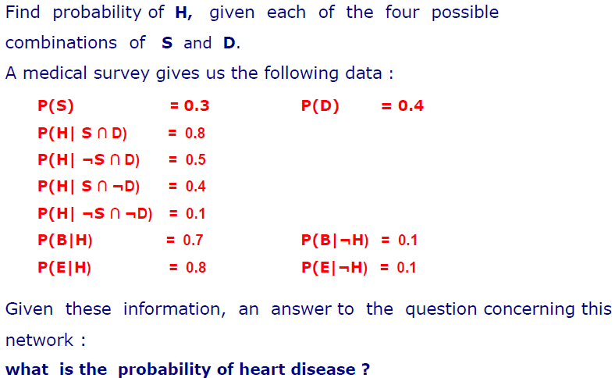
Practice Question

Slide 42
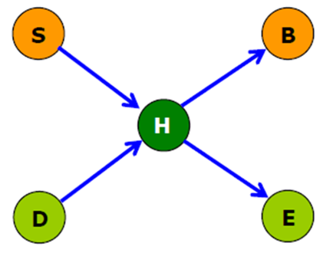
Practice Question
H | P(B=T|H)
T | 0.7
F | 0.1
P(S=T)
0.3
H | P(E=T|H)
T | 0.8
F | 0.1
P(D=T)
0.4
S | D | P(H=T|P,S
T | T | 0.8
F | T | 0.5
T | F | 0.4
F | F | 0.1

Slide 43
Practice Question
In a Bayesian Network if you wish to know the probability that node N, say, is true, you need to look at its parent nodes (i.e. its causes). You need to list all possible combinations of the values of the parent nodes and then consider the probability that N is true for each combination.
In this problem we have to consider all the possible combinations of the two parent nodes S and D. In this case there are four of them, so there are four ways he can have heart disease (H):
He smokes and has bad diet and he has heart disease
He does not smoke and has bad diet and has heart disease
He smokes and does not have bad diet and has heart disease
He does not smoke and does not have bad diet and has heart disease

Slide 44
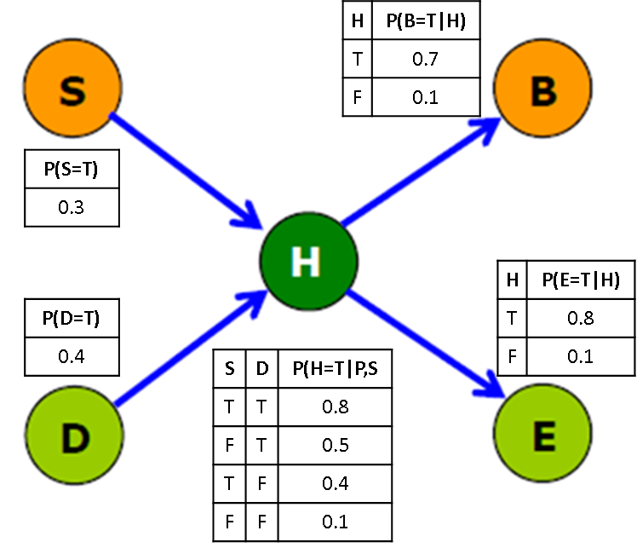
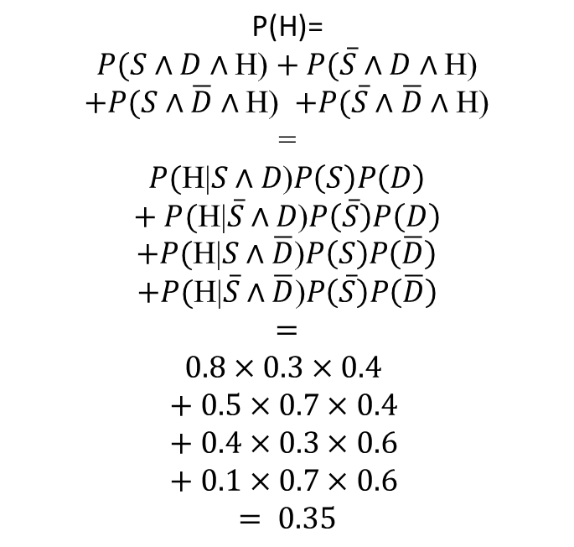
Practice Question
$$\text{P}\text{(}\text{H}\text{)=}$$
$$P(S∧D∧\text{H}\text{)}+ P(\overline{S}∧D∧\text{H}\text{)}$$
$$+P(S∧\overline{D}∧\text{H}\text{)}+P(\overline{S}∧\overline{D}∧\text{H}\text{)}$$
=
$$P(\text{H}\text{|}S∧D\text{)}P\left(S\right)P\left(D\right)$$
$$+ P(\text{H}\text{|}\overline{S}∧D\text{)}P\left(\overline{S}\right)P\left(D\right)$$
$$+P(\text{H}\text{|}S∧\overline{D}\text{)}P\left(S\right)P\left(\overline{D}\right)$$
$$+P(\text{H}\text{|}\overline{S}∧\overline{D}\text{)}P\left(\overline{S}\right)P\left(\overline{D}\right)$$
$$=$$
$$0.8×0.3×0.4$$
$$+ 0.5×0.7×0.4$$
$$+ 0.4×0.3×0.6$$
$$+ 0.1×0.7×0.6$$
$$= 0.35$$

Slide 45
Practice Question
Suppose we wish to know the probability of heart disease and smoking, i.e. you are told that a patient smokes and has heart disease, but you do not know whether he has bad diet or not. There are two ways in which a patient could have heart disease and smoke: they are
He smokes and has bad diet and he has heart disease
He smokes and does not have bad diet and has heart disease

Slide 46
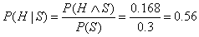
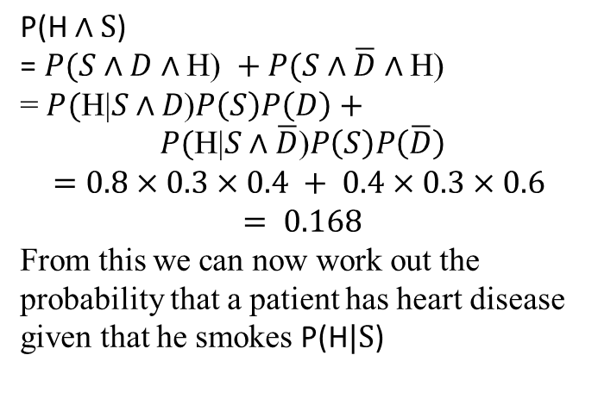
Practice Question
$$\text{P}\text{(}\text{H}∧\text{S}\text{)}$$
$$\text{=}P(S∧D∧\text{H}\text{) }+P(S∧\overline{D}∧\text{H}\text{)}$$
= $P(\text{H}\text{|}S∧D\text{)}P\left(S\right)P\left(D\right)+$
$$P(\text{H}\text{|}S∧\overline{D}\text{)}P\left(S\right)P\left(\overline{D}\right)$$
$$=0.8×0.3×0.4 + 0.4×0.3×0.6$$
$$= 0.168$$
From this we can now work out the probability that a patient has heart disease given that he smokes $\text{P}\text{(}\text{H}|\text{S}\text{)}$

Slide 47
Practice Question
Suppose we wish to know the probability of having an abnormal electrocardiogram (ECG) given that a patient smokes, i.e. you are told a patient smokes, but you do not know whether he has bad diet or whether he has heart disease.
An abnormal ECG is caused by H heart disease which is in turn caused by smoking S. So, we have a chain of cause and effect. But we do not know the value of the middle link H in this chain. So, we have to consider each possible value of H as follows
He smokes and has heart disease and has abnormal ECG
He smokes and does not have heart disease and has abnormal ECG

Slide 48
References
Chapter 13: Quantifying Uncertainty , Pages 480-530
“Artificial Intelligence: A Modern Approach,” by Stuart J. Russell and Peter Norvig

Slide 49
Books
“Artificial Intelligence: A Modern Approach,” by Stuart J. Russell and Peter Norvig.
"Artificial Intelligence: Structures and Strategies for Complex Problem Solving", by George F. Luger, (2002)
"Artificial Intelligence: Theory and Practice", by Thomas Dean.
"AI: A New Synthesis", by Nils J. Nilsson.
“Programming for machine learning,” by J. Ross Quinlan,
“Neural Computing Theory and Practice,” by Philip D. Wasserman, .
“Neural Network Design,” by Martin T. Hagan, Howard B. Demuth, Mark H. Beale, .
“Practical Genetic Algorithms,” by Randy L. Haupt and Sue Ellen Haupt.
“Genetic Algorithms in Search, optimization and Machine learning,” by David E. Goldberg.
"Computational Intelligence: A Logical Approach", by David Poole, Alan Mackworth, and Randy Goebel.
“Introduction to Turbo Prolog”, by Carl Townsend.

